Slide 1
Locker Project
Team Members:
Tijmen Van Der Beek
Miren Patel
Siquan Wang
Xiaoang Zhang
Dazhou Liu

Slide 2
Introduction
The Depew High School locker project focuses on customized lockers for individuals with physical disability. According to the needs of the client, each lock has to be designed specifically for each user to solve their problem with accessing the locker independently.
The purpose of the Alden High School Locker is to design an automated and easily operated locker for Alden High School. The locker we designed is a prototype and the idea is that they can run multiple of them off of one battery.

Slide 3
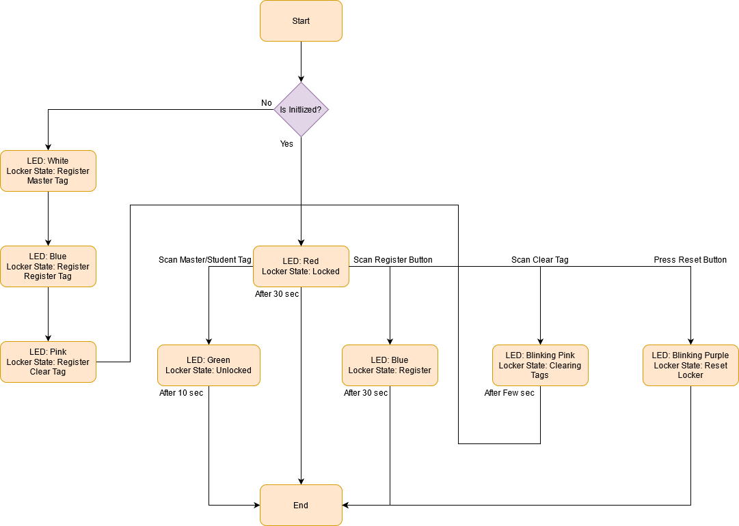
Alden Flowchart

Slide 4
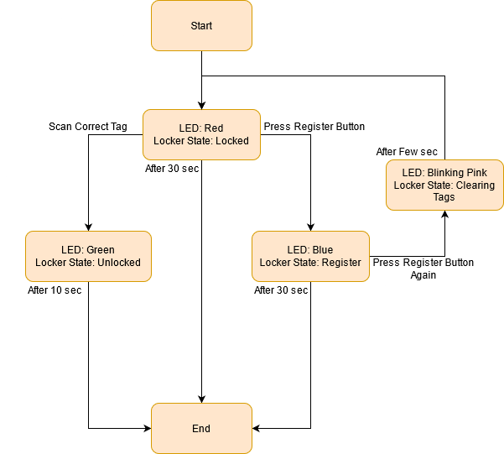
Depew Flowchart

Slide 5
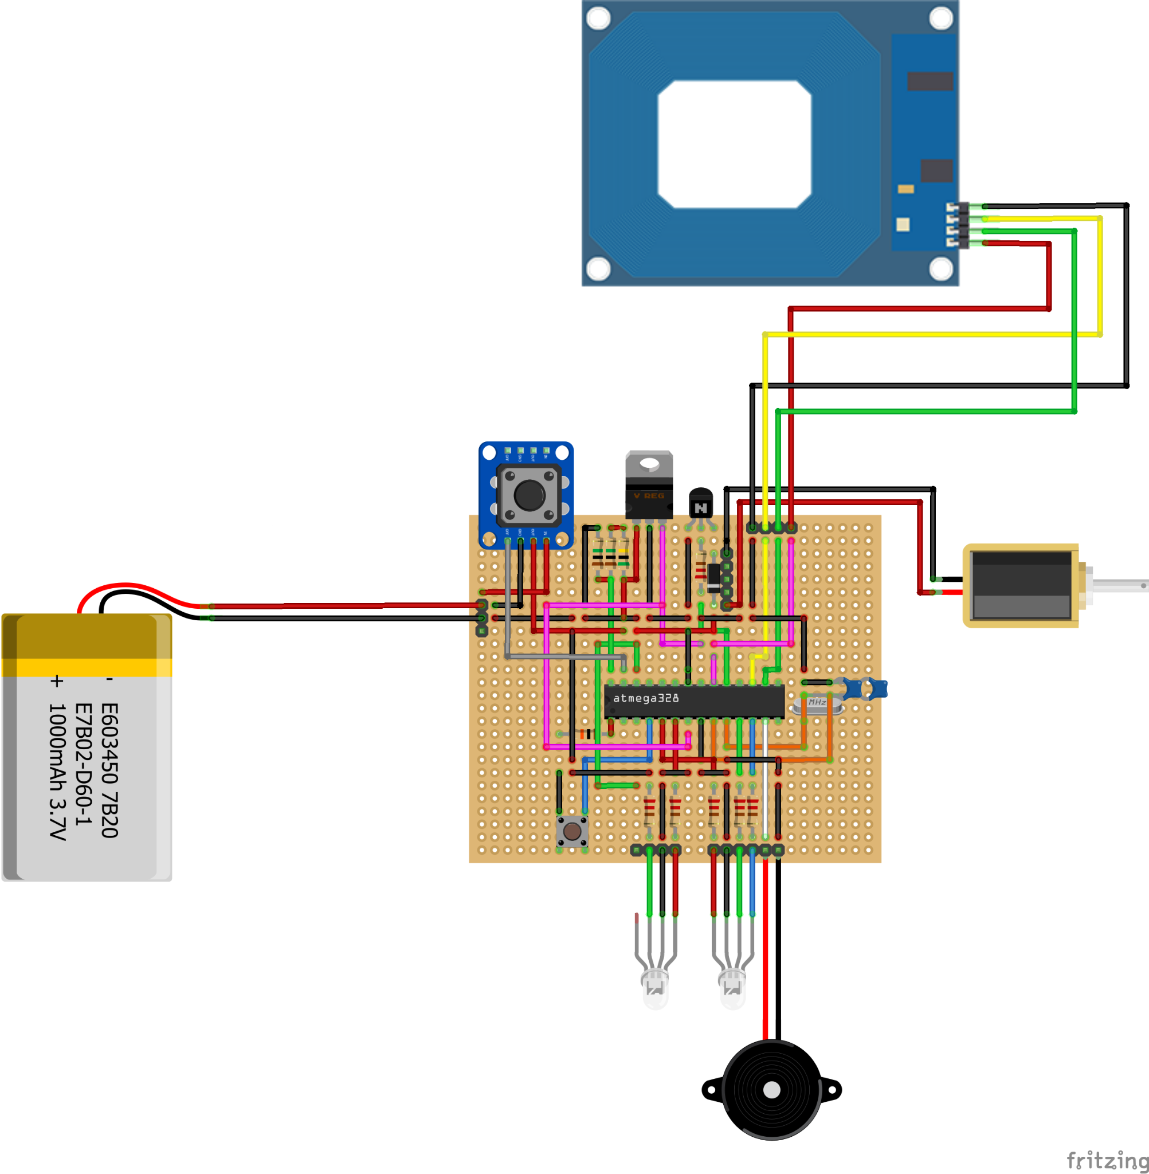
Schematic
Major Components:
DeWalt 12v Lithium Ion Battery
RFID Card Reader
Solenoid
5V 2 Terminals Buzzer

Slide 6
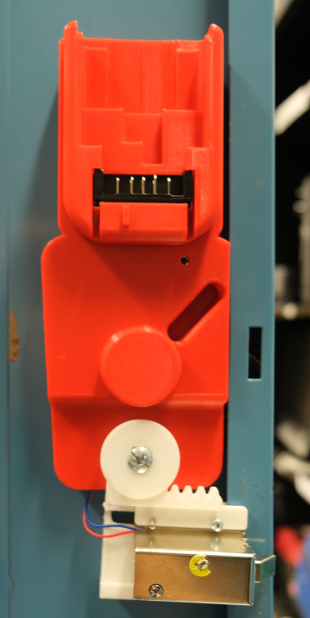
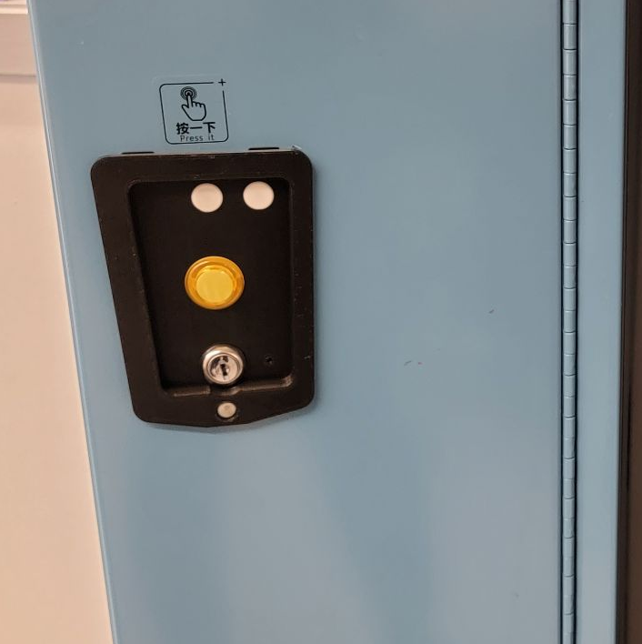
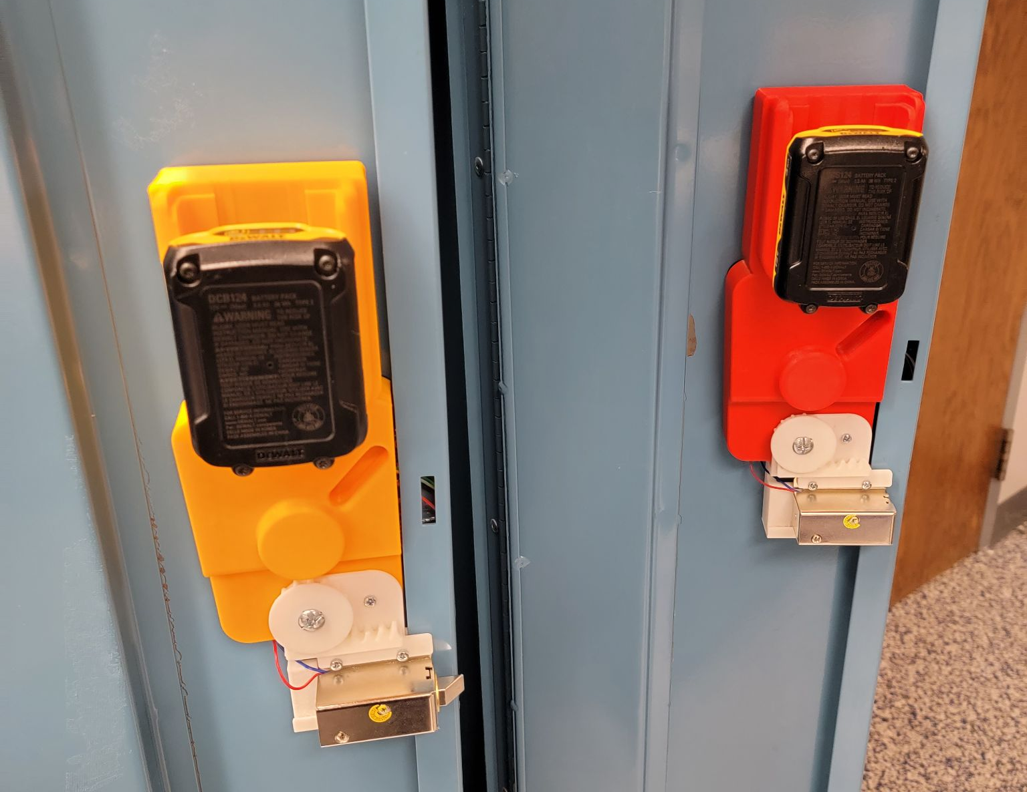
Case Outside

Slide 7
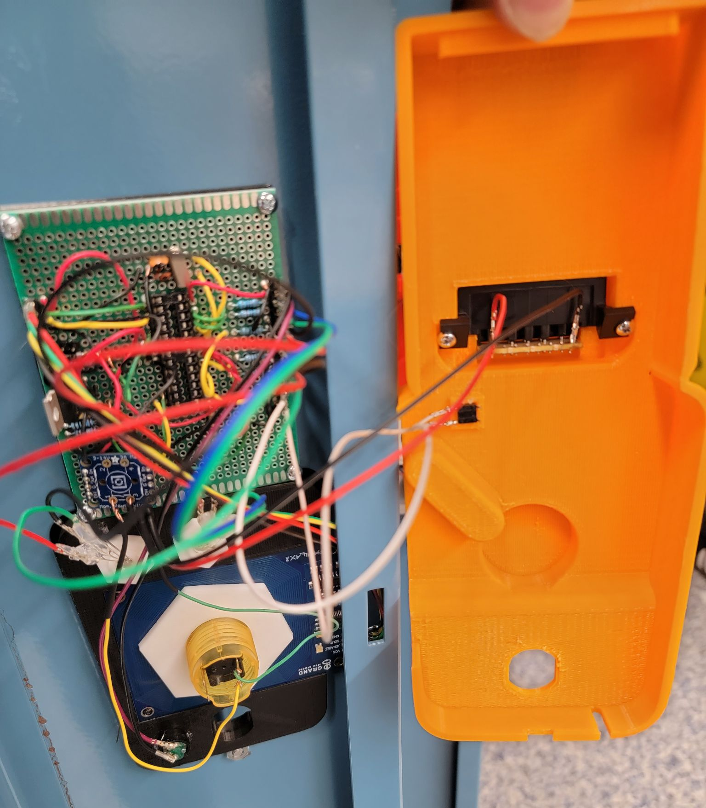
Case Inside

Slide 8
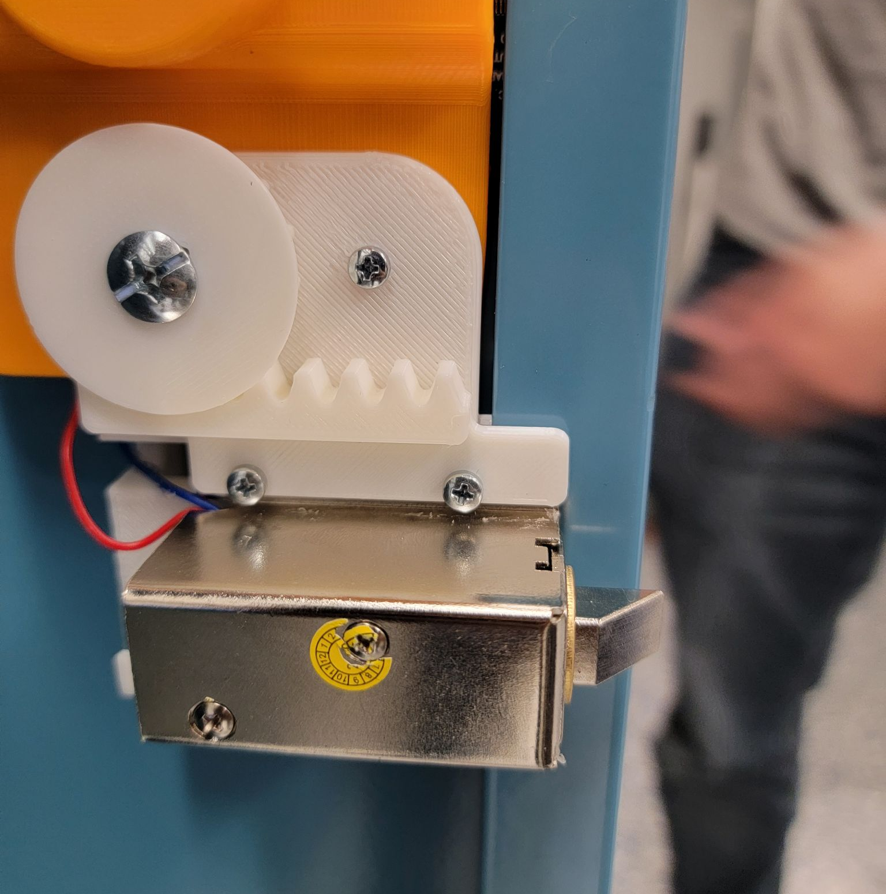
Mechanical Override
We used a gear and rack to move the solenoid horizontally for achieving the manual override feature.

Slide 9
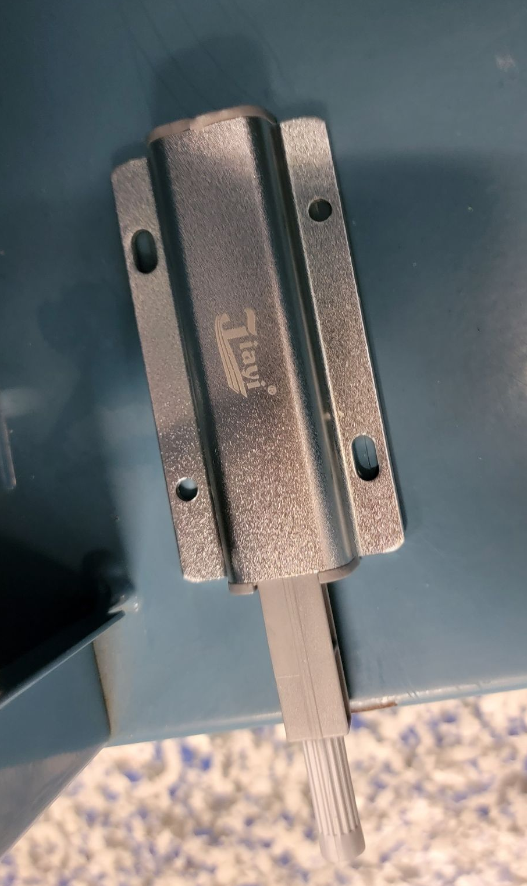
Depew Locker Spring
We install a magnetic push latch for each locker. This latch push open the door automatically once unlock.

Slide 10
Possible Upgrades
Improve Mechanical Override
Manufactured Circuit Board
Improve some parts of the case
Design a case that works with the Alden Latch
Design it with a bigger battery like 20v Dewalt
Disable reset button to Students
Put multiple lockers in parallel with one battery
Improve on issues that come up during testing
Improve energy efficiency

Slide 11
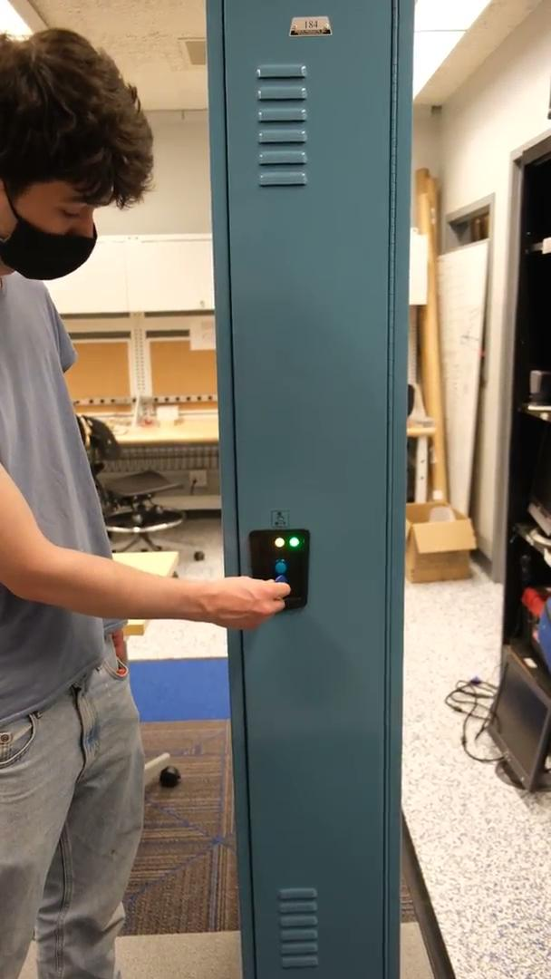
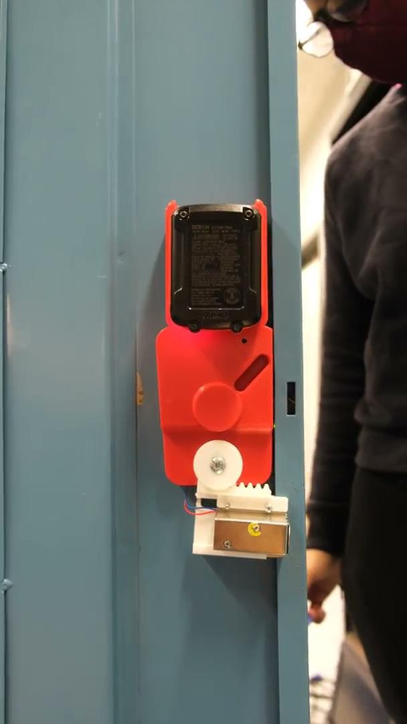

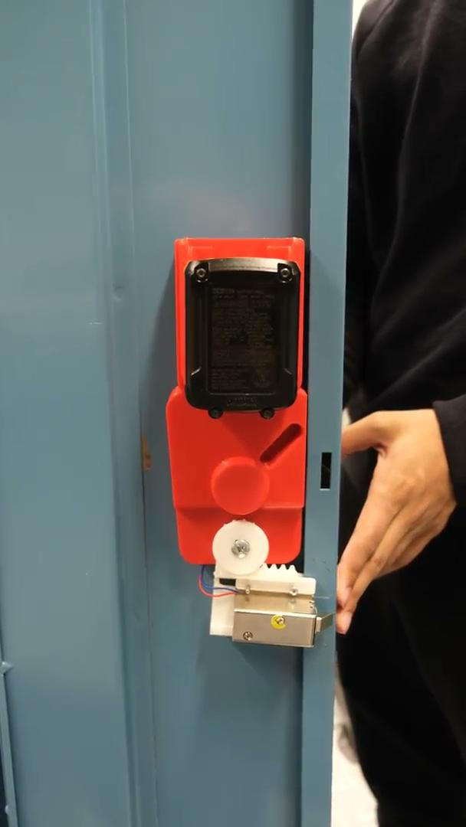
Demo
Open (Outside View):
Open (Inside View):
Register & Clearing :
Mechanical Override:

